Slide 1

USMMA’s Sexual Assault Prevention and Response Program
New Sexual Assault Prevention & Response Policy Briefing to Midshipmen
Mr. Jay C. Velis
Sexual Assault Response Coordinator
Our Mission - provide an effective sexual assault prevention and response training program; manage a robust 24/7 response capability around the clock. Coordinate synchronized supporting services to victims of sexual assault. Committed to creating a living and working environment that upholds the Academy’s honor code, ensures safety, and respects the dignity of every member of the Academy community.
”Sexual Assault prevention is a team effort
ONE TEAM ONE FIGHT!”
Notes:
Welcome participants back:
- Introduce self and title: SARC from SAPR office
Discuss purpose of briefing, why it is important for newcomers; increased risk of assault when new to an area
Provide folks with the numbers for local resources

Slide 2
Purpose
To eliminate sexual assault through a robust set of training requirements, and to handle victims of sexual assault with the utmost dignity and respect.
To enhance policy and direction which will synchronize both on/off campus resources to effectiveness.
To maintain an active sexual assault prevention campaign throughout the year!!

Slide 3
Applicability
This policy applies to all Academy personnel, including:
Midshipmen
Faculty
Staff
Personnel of tenant agencies
Federal employees
Military personnel
NAFI employees
Contract employees

Slide 4
USMMA Policy
Academy is committed to maintaining a safe campus at which Midshipmen can learn and mature in an environment free of violence, harassment, hazing and sexual misconduct.
Each member of the Academy community is responsible for fostering mutual respect, for being familiar with this policy and for refraining from conduct that violates this policy.
Sexual assault will not be tolerated.

Slide 5
USMMA Policy - Cont.
The Academy will use training, education, and awareness to eliminate sexual assault.
The Academy will promote sensitive handling of victims of sexual assault.
The Academy will offer victim assistance and counseling.
The Academy will hold those who commit sexual assault offenses accountable

Slide 6
Victim Rights
The right to be treated with fairness and with respect for their dignity and privacy.
The right to immediate and effective medical care and attention, including long-term treatment, if eligible.
The right to be reasonably protected from the accused offender.
The right to be notified of court proceedings.
The right to be present at all public court proceedings

Slide 7
Victim Rights - Cont.
The right to talk to the attorney for the Government in the case.
The right to restitution, if appropriate.
The right to information about the conviction, sentencing, imprisonment, and release of the offender from custody.
The right, if desired, to confidential or restricted reporting of the sexual assault incident.

Slide 8
Definition of Sexual Assault
Sexual assault is intentional sexual contact, characterized by use of force, physical threat, or abuse of authority, or when the victim does not or can’t consent.
Sexual assault can occur without regard to gender or spousal relationship or the age of the victim.
“Consent “ shall not be deemed or construed to mean the failure by the victim to offer physical resistance. Consent is not given when a person uses force, threat of force, coercion or when the victim is asleep, incapacitated, or unconscious.

Slide 9
Examples of Sexual Assault
Unwanted kissing, groping, fondling or other more aggressive acts, such as rape, nonconsensual sodomy (oral or anal sex), or attempts to commit these acts.
Sexual contact with someone whom you reasonably should have known was impaired due to the use of alcohol or drugs (including prescription medications).
Sexual contact with someone who is unable to say “no” and/or change their mind due to presence of coercion or intimidation.

Slide 10
Procedures
Victims of sexual assault are strongly encouraged to report such assaults as soon as possible.
Whether the assault took place on or off campus.
A victim of sexual assault has the option to make either a restricted or unrestricted report.

Slide 11
Restricted Reporting
Allows Midshipmen who are victims of sexual assault to report their incident to specifically identified individuals and receive services such as medical, victim advocacy, counseling without initiating an investigation.
Reports must be reported only to: SARC, Victim Advocates, Health Care Services and the Chaplains.
Victims have the option to request an investigation later on if desired. Evidence can also be collected and retained for up to one year for use on an investigation.

Slide 12
Unrestricted Reporting
Allows Midshipmen who are victims of sexual assault to receive services such as medical, victim advocacy, counseling, protection from accuser, law enforcement and an official investigation of the incident.
Reports must be reported to: SARC, Victim Advocates, Health Care Services and the Chaplains, law enforcement, Chain of Command, faculty, etc.
The Federal Bureau of Investigation will be notified for an immediate investigation. An administrative investigation may also be initiated pending the FBI’s findings.

Slide 13
Requirement to Report
Allegations of sexual assault must be reported to the SARC for proper action.
If unsure if something is or is not an incident, report the incident to the SARC.
Best policy is to refer the person to the SARC to facilitate direction to move forward.
Just call if you have doubts, better to be safe than sorry.

Slide 14
Consequences of Not Reporting
Inconsistent with Academy Values of Honor and Integrity
Inability of authorities to conduct a timely and thorough investigation
Inability of chain of command to
  Appropriately care for victims
  Discipline perpetrators
Possibility that perpetrator may assault others
Inability of Academy to provide medical care and counseling

Slide 15
Imminent Danger
Proper actions will be taken any time there is imminent danger to the victim or to others.
Sometimes victims develop suicidal ideations.
Sometimes victims want to take the law into their own hands.

Slide 16
Disciplinary Actions
In addition to any criminal proceedings that may be instituted by federal or local law enforcement, the Academy may:
Pursue investigative and disciplinary proceedings pursuant to the Midshipman Regulations.
Investigate and discipline employees pursuant to the Maritime Administrative Order (MAO) 770-751, Disciplinary and Adverse Actions.

Slide 17
Prohibition Against Retaliation
No individual shall be retaliated against in any way by a member of the Academy community for participation in this complain procedure.
Every effort will be made to protect members of the Academy community so that they may use or participate in this complaint procedure without reprisal or retaliatory action.
Notify the SARC if needed.

Slide 18
Alleged Victim Misconduct
The Academy will defer adjudication of any collateral violations of the victim until the final disposition of the sexual assault case.
The chain of command should take into account the trauma to the victim and respond appropriately so as to encourage reporting of sexual assault.
Sexual assault is a felony, underage drinking is not!!

Slide 19
Education and Training
Midshipmen – Quarterly, Plebe Candidates, Pre and Post Sea Year, Midshipmen key leaders
Faculty and staff – Annually to include a specific session for key leaders
First Responders – Medical, Public Safety, Chaplain, Legal, EMTs, and Victim Advocates

Slide 20
Resources Available
Victim Advocacy by SARC and Victim Advocates.
Counseling by Academy staff, by rape crisis center, or by Chaplain.
Investigation and victim/witness support by the local FBI office.
Chain of command support such as protection, relocation, etc.

Slide 21
Victim’s Emotional Effects
Anxiety
Powerlessness
Disorganization
Self-blame
Distorted self-image
Depression
Withdrawal
Individual reactions vary widely

Slide 22
Risk Factors
Alcohol is involved in 95% of sexual assault incidents.
Watch your drink and never leave unattended due to date rape drugs.
Most incidents are committed by persons known to the victim: friends, colleagues, supervisors, etc.
Sexual Harassment situations that go unresolved sometimes lead to sexual assault.
Use situational awareness, and if something does not feel right, trust your instincts!!

Slide 23
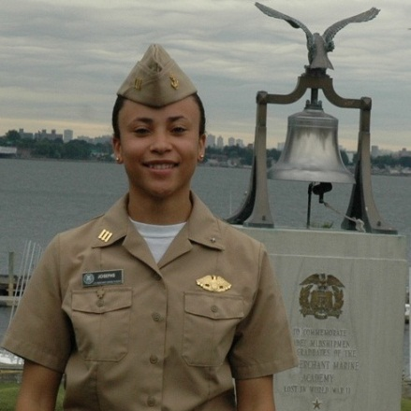
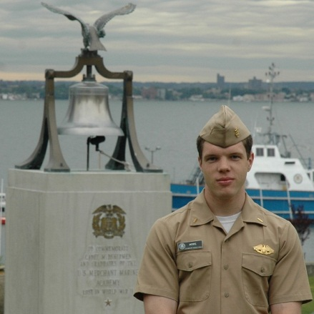
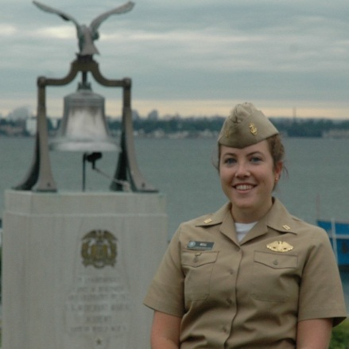
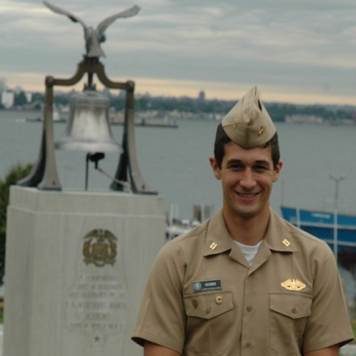
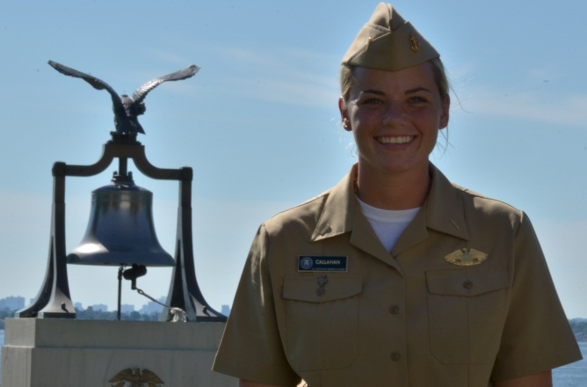
Sexual Assault Victim Advocates
M/N Josephs
Regimental SAVA
M/N Merkl
1st Co SAVA
M/N Bell
1st Co SAVA
Photo Unavailable
M/N Gober
2nd Co SAVA
M/N Callahan
2nd Co SAVA

Slide 24
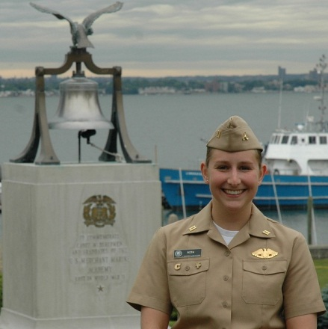
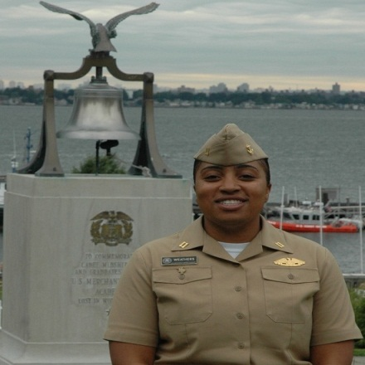
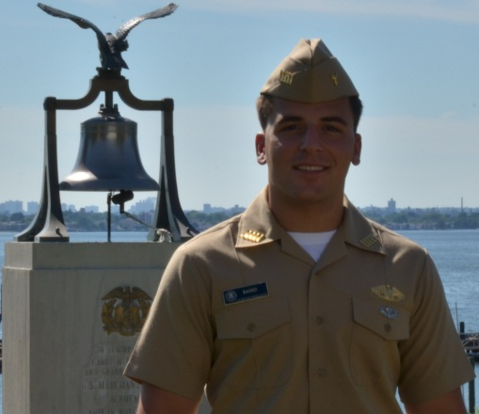
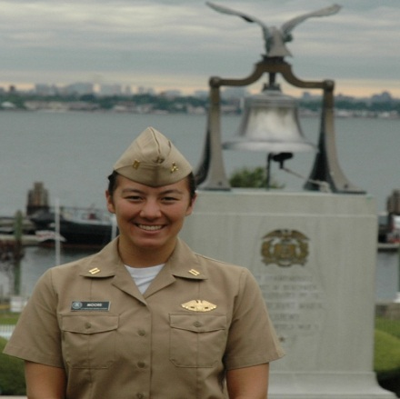
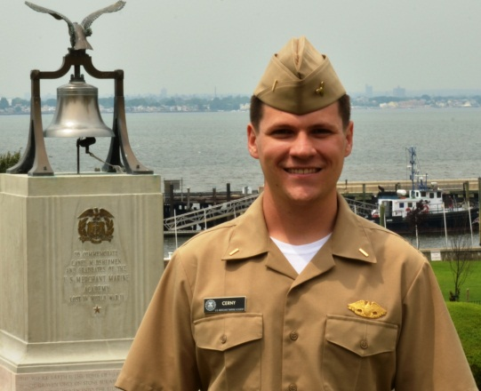
Sexual Assault Victim Advocates
M/N Roth
3rd Co SAVA
M/N Weathers
4th Co SAVA
M/N Basso
4th Co SAVA
M/N Moore
Band Co SAVA
M/N Cerny
Band Co SAVA

Slide 25
SARC
Need to contact the SARC, see below:
BlackBerry: (516) 462-3207 24/7 Access
Home: (516) 439-4731
Office: (516) 726-6153
Office: Second deck of the library
Live on campus at Quarters E
E-Mail: velisj@usmma.edu

