Slide 1
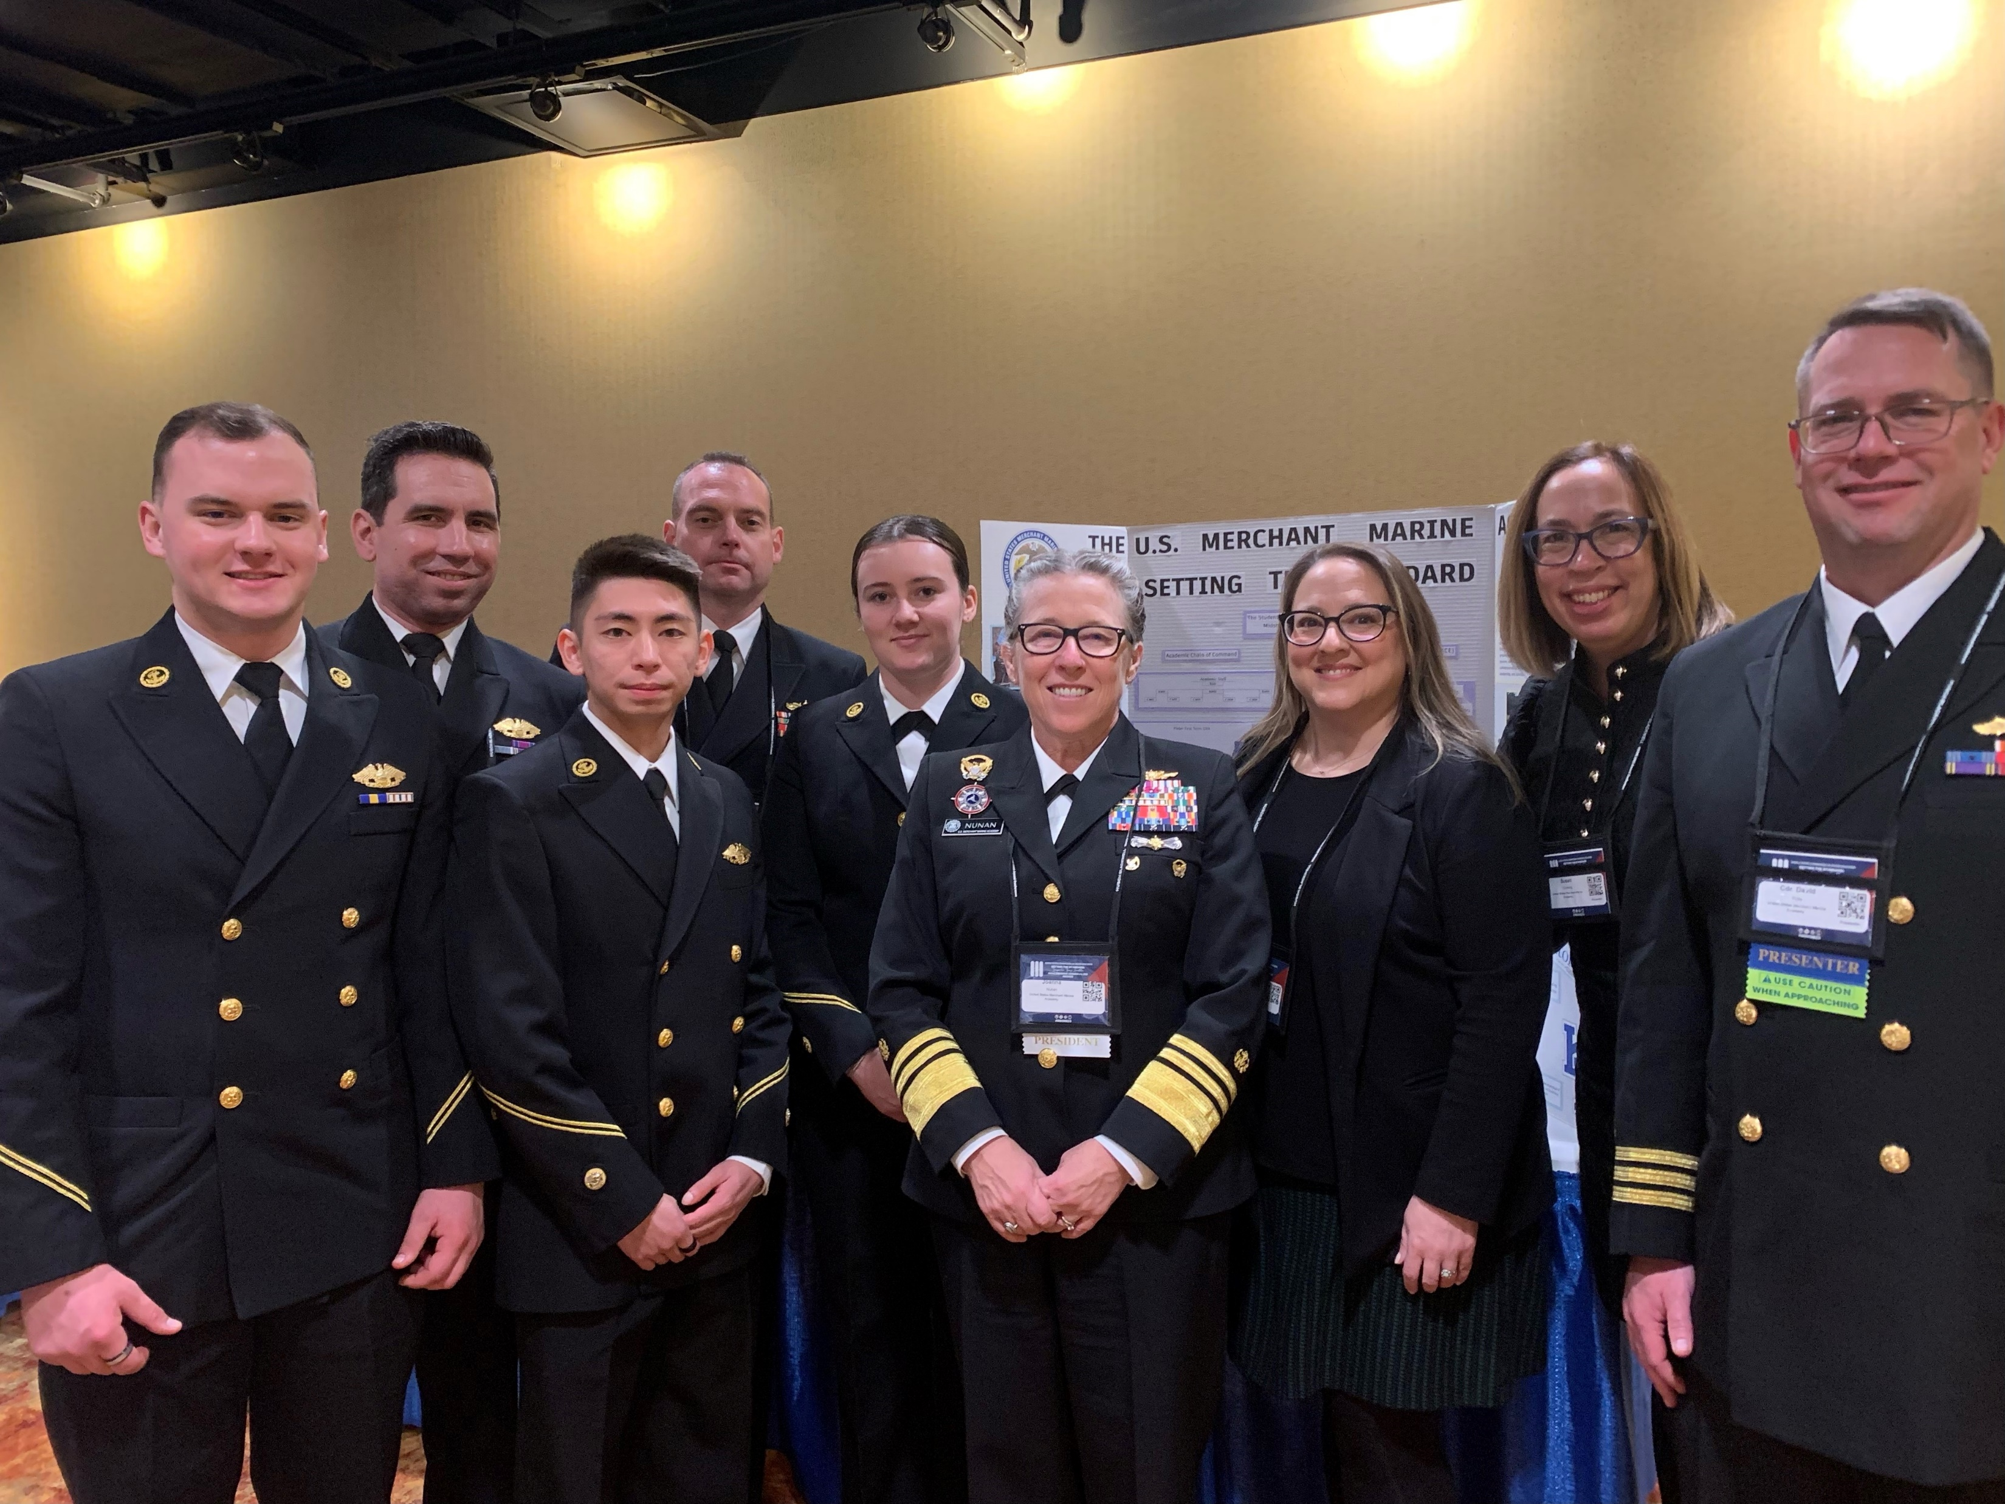

USMMA
Middle States Commission on Higher Education (MSCHE)
Self-Study Update
& Strategic Plan Alignment

Slide 2
Purpose of the Self-Study
Maintain the Academy’s Middle States Commission
on Higher Education Accreditation
Demonstrate that the Academy fully meets the MSCHE
7 Standards & Requirements of Affiliation
Conduct a successful Self-Study with evidence to support our
adherence to the MSCHE 7 Standards for Accreditation
Align the Self-Study with the Academy’s new Strategic Plan
and Organizational Chart (MAO-150)
Examine and assess all policy, practice, and procedure related
to the Academy with continuous improvement in mind

Slide 3
Self-Study Advisory Board
Dr. Lori Townsend: Accreditation Liaison Officer (Director of Institutional Assessment)
Dr. Jennifer Albert: Self-Study Steering Committee Chair (ACE Deputy Director)
Captain James Zatwarnicki: Self-Study Steering Committee Co-Chair (Acting Provost/Associate Dean for Faculty Affairs)
Dr. Susan Comilang: Advisory Board Member (Assistant Dean for Academic Affairs)
Captain Paul Acquaro: Advisory Board Member/Chair of the Strategic Planning Committee (ACE Director)
Captain Preston DeJean: Advisory Board Member (Associate Professor, Marine Transportation)
Dr. Alex Retakh: Data & Assessment Subcommittee Chair (Professor of Mathematics)
MIDN Charles Ross: MSCHE Midshipman Liaison (Class of 2024)
MIDN Kennedy Maddock: MSCHE Midshipman Liaison (Class of 2024)

Slide 4
MSCHE Self-Study Steering Committee
Dr. Jennifer Albert: Chair, Self-Study Steering Committee (ACE Deputy Director)
Captain James Zatwarnicki: Co-Chair, Self-Study Steering Committee (Acting Provost/Associate Dean for Faculty Affairs and Assistant Professor, Department of Marine Transportation)
Mr. Thomas O’Boyle: Chair, Standard I – Mission & Goals (Director of Student Activities)
Captain Patrick Keane: Chair, Standard II – Ethics & Integrity (Director of Leadership & Ethics, Commandant’s Department)
Commander Carolyn Hunter: Chair, Standard III – Design & Delivery of the Student Learning Experience (Assistant Department Head, Marine Transportation and Sea Project Coordinator)
Coach Michael Notebaert: Chair, Standard IV – Support of the Student Experience (Assistant Athletic Director for Facilities, Head Baseball Coach)
Dr. Pamela Bryant: Chair, Standard V – Educational Effectiveness Assessment (Chemistry and Physics Lab Manager, Department of Math & Science)
Captain Peter Kahl: Chair, Standard VI – Planning, Resources & Institutional Improvement (Associate Professor, Department of Marine Engineering)
Commander David Pulis: Chair, Standard VII – Governance, Leadership & Administration (Assistant Dean for Support Programs and Associate Professor, Department of Marine Engineering)
*All 7 Standards Working Groups in the process of discovery, analysis, drafting reports*

Slide 5
MSCHE Self Study Timeline
United States Merchant Marine Academy
2023
2024
2023
2024
2024
September-November
December
January-March
February-March
April - May
Communications Plan
VP Liaison
Campus Visit
MSCHE Conference
SN & Call for Proposals
MSCHE Team Chair
MSCHE VP Liaison Dr. Anne Wahl Visits USMMA; Self-Study Design Approved
VDML Nunan in Attendance; Workshop Presented by Capt. Paul Acquaro, Dr. Susan Comilang & CDR David Pulis; Student Poster Session Participants MIDN Dellaria, Robinson & Sullivan
Director of External Affairs & Director of Student Activities Implement Strategy for Communications Plan
SN 2024-03 USMMA Strategic Plan 2024-2030; MSCHE Annual Conference 2024 Call for Proposals Deadline 3/15
MSCHE Visiting Team Chair Selection; Preliminary Draft of the Self-Study Under Review by the Steering Committee

Slide 6
Critical Alignments
USMMA Self-Study 2016 MSCHE Warnings | MSCHE Standards & Requirements of Affiliation | USMMA Strategic Plan 2024-2030 (Pending) Institutional Priorities | USMMA Self-Study 2024
Requirement of Affiliation 7 | Institutional Planning | Academy Infrastructure | Standards I, II, III, VI, VII RoA 10, 11, 13
Standard 2 | Planning, Resources, and Institutional Renewal | Academy Infrastructure | Standards I, II, III, IV, V, VI, VII RoA 10, 11, 13
Standard 3 | Institutional Resources | Academy Infrastructure | Standards I, II, III, IV, VI, VII RoA 5, 6, 11
Standard 4 | Leadership and Governance | Governance, Leadership and Administration | Standards I, II, VII RoA 5, 6, 7, 12, 13, 14
Standard 5 | Administration | Governance, Leadership and Administration | Standards I, II, VII RoA 5, 6, 7, 12, 13, 14
Standard 9 | Student Support Services | Institutional Culture | Standards I, II, III, IV, VI, VII RoA 8, 10, 14, 15
Other: Evidence of resource allocation decisions directly linked to mission and goal achievement at the institutional and unit level | Standard 2; RoA 7 | Governance, Leadership and Administration | Standards I, II, III, IV, V, VI RoA 5, 6, 7, 12, 14
Other: Further development and implementation of an organized and sustained institutional assessment process, including evidence that assessment results are used to inform decision-making | Standard 2; RoA 7 | Educational Program | Standards I, II, III, IV, V, VI RoA 2, 8, 9, 10, 15

Slide 7
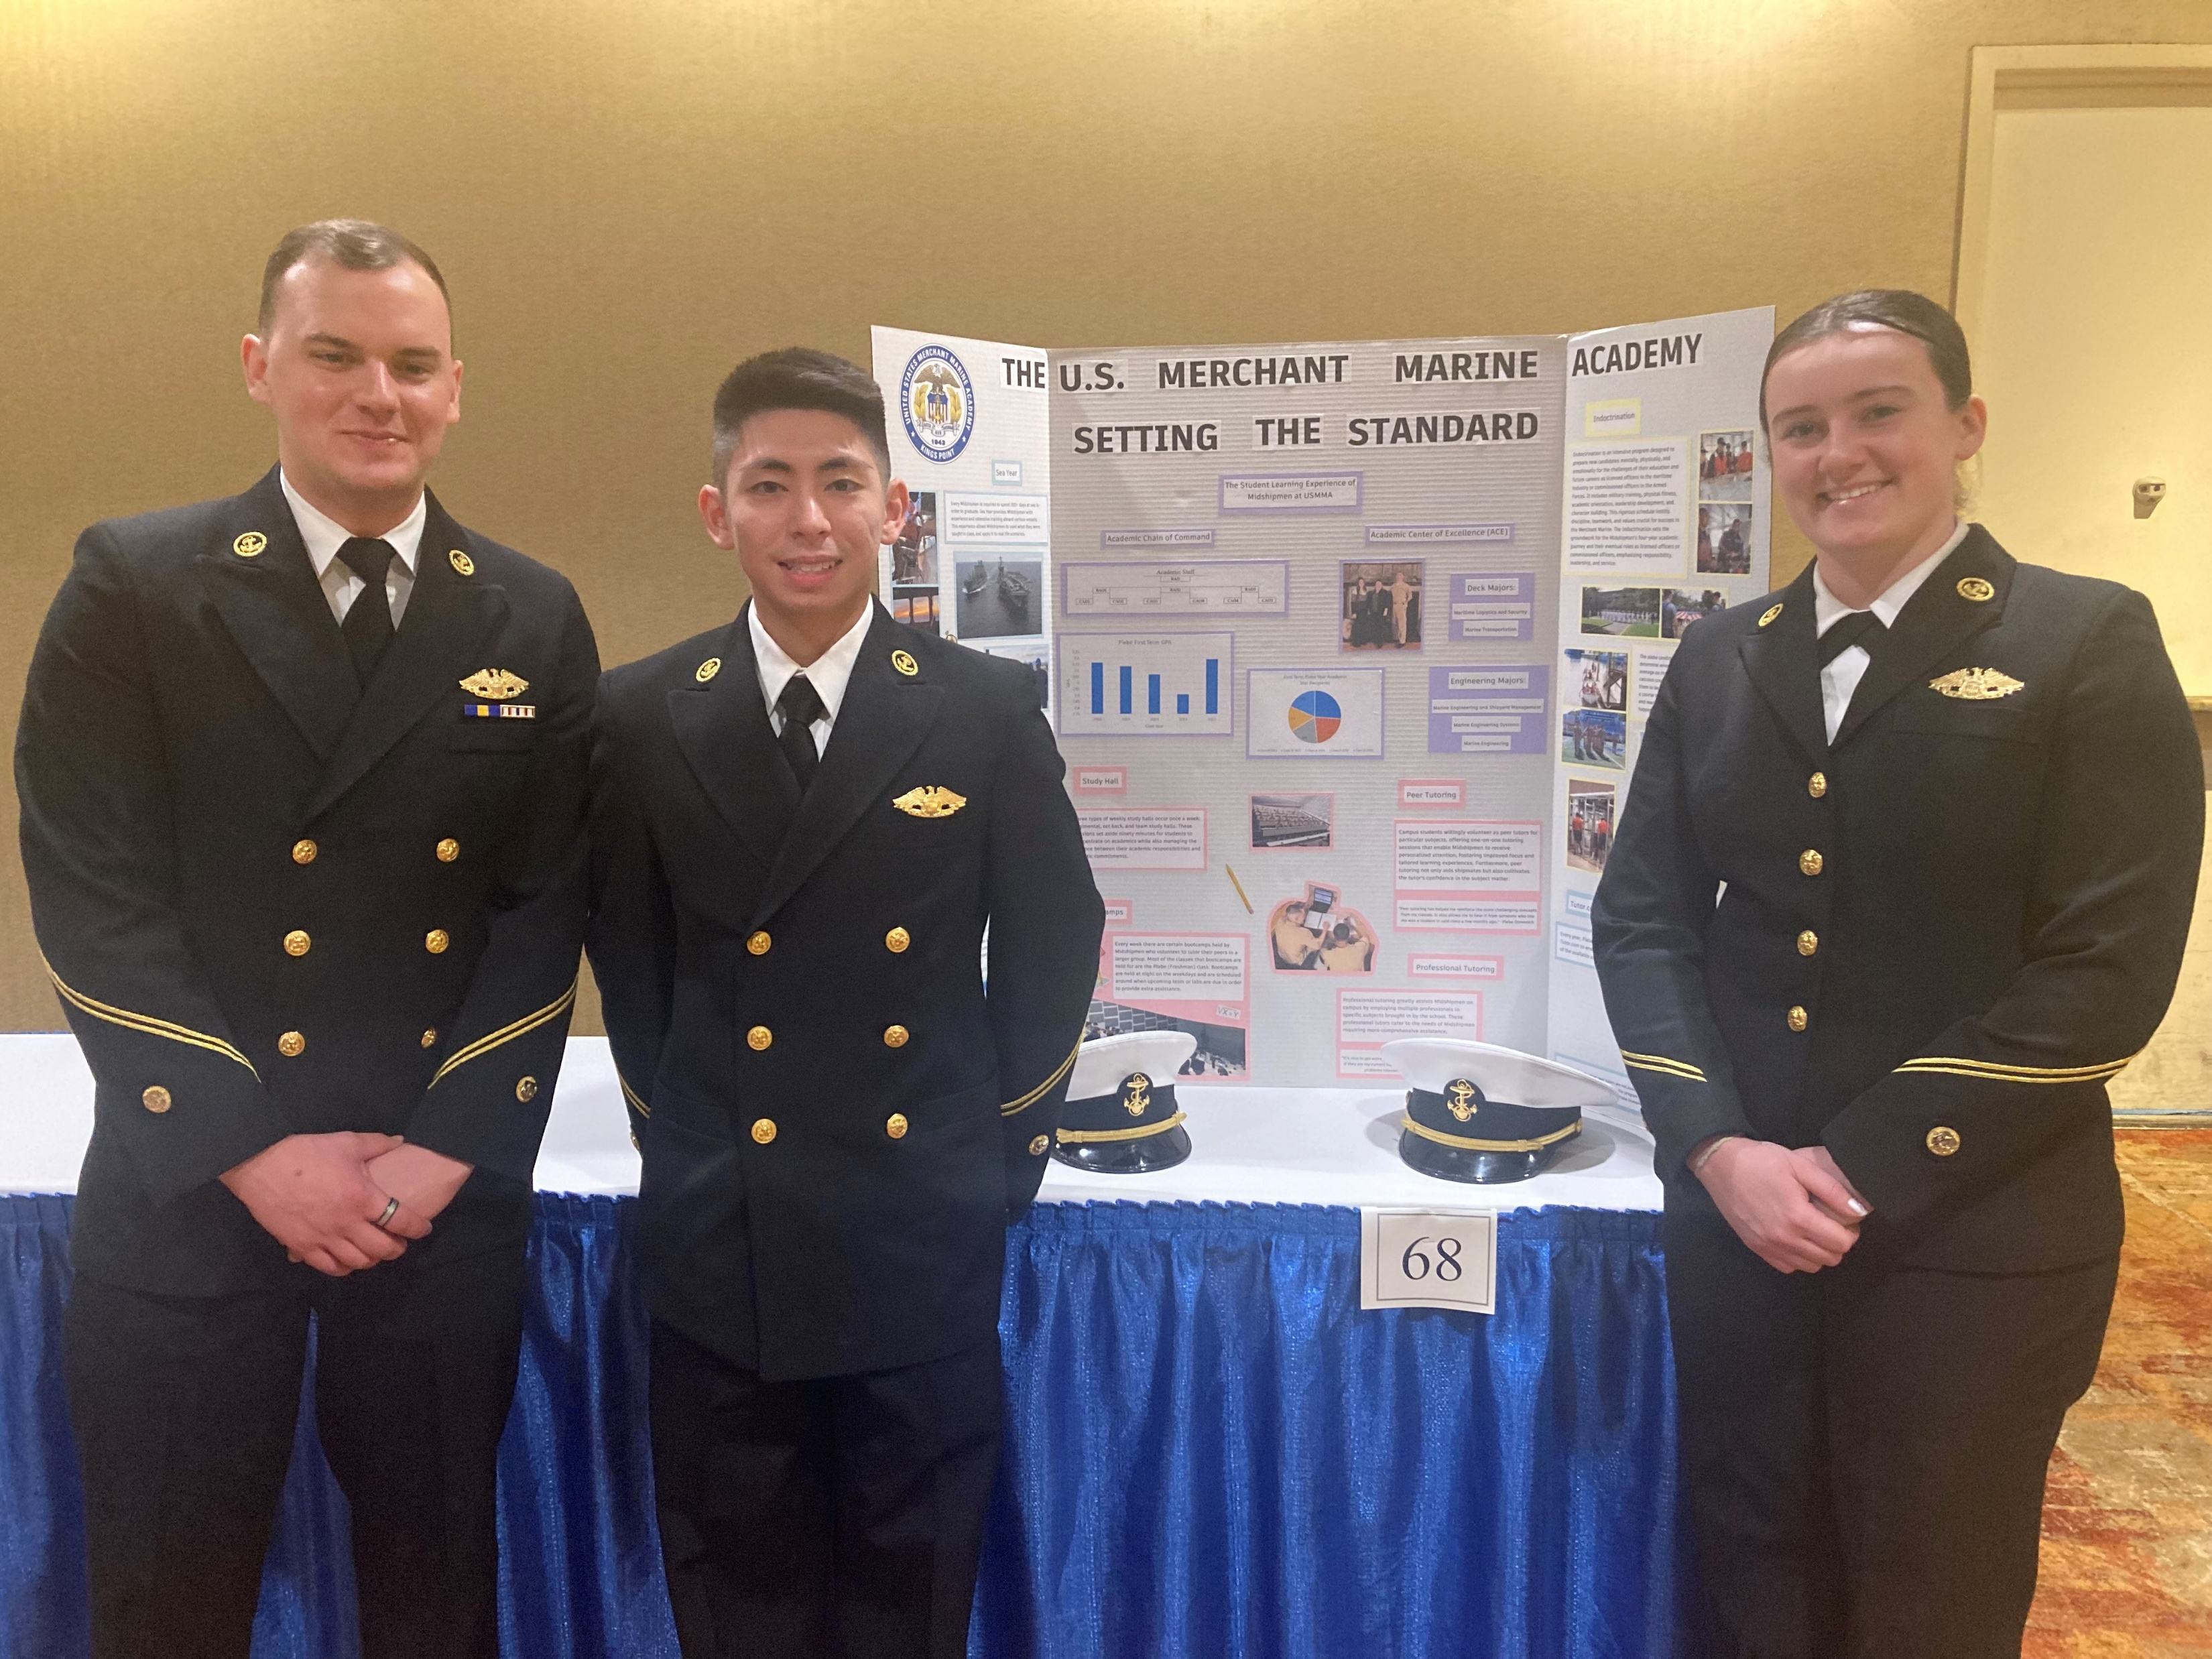
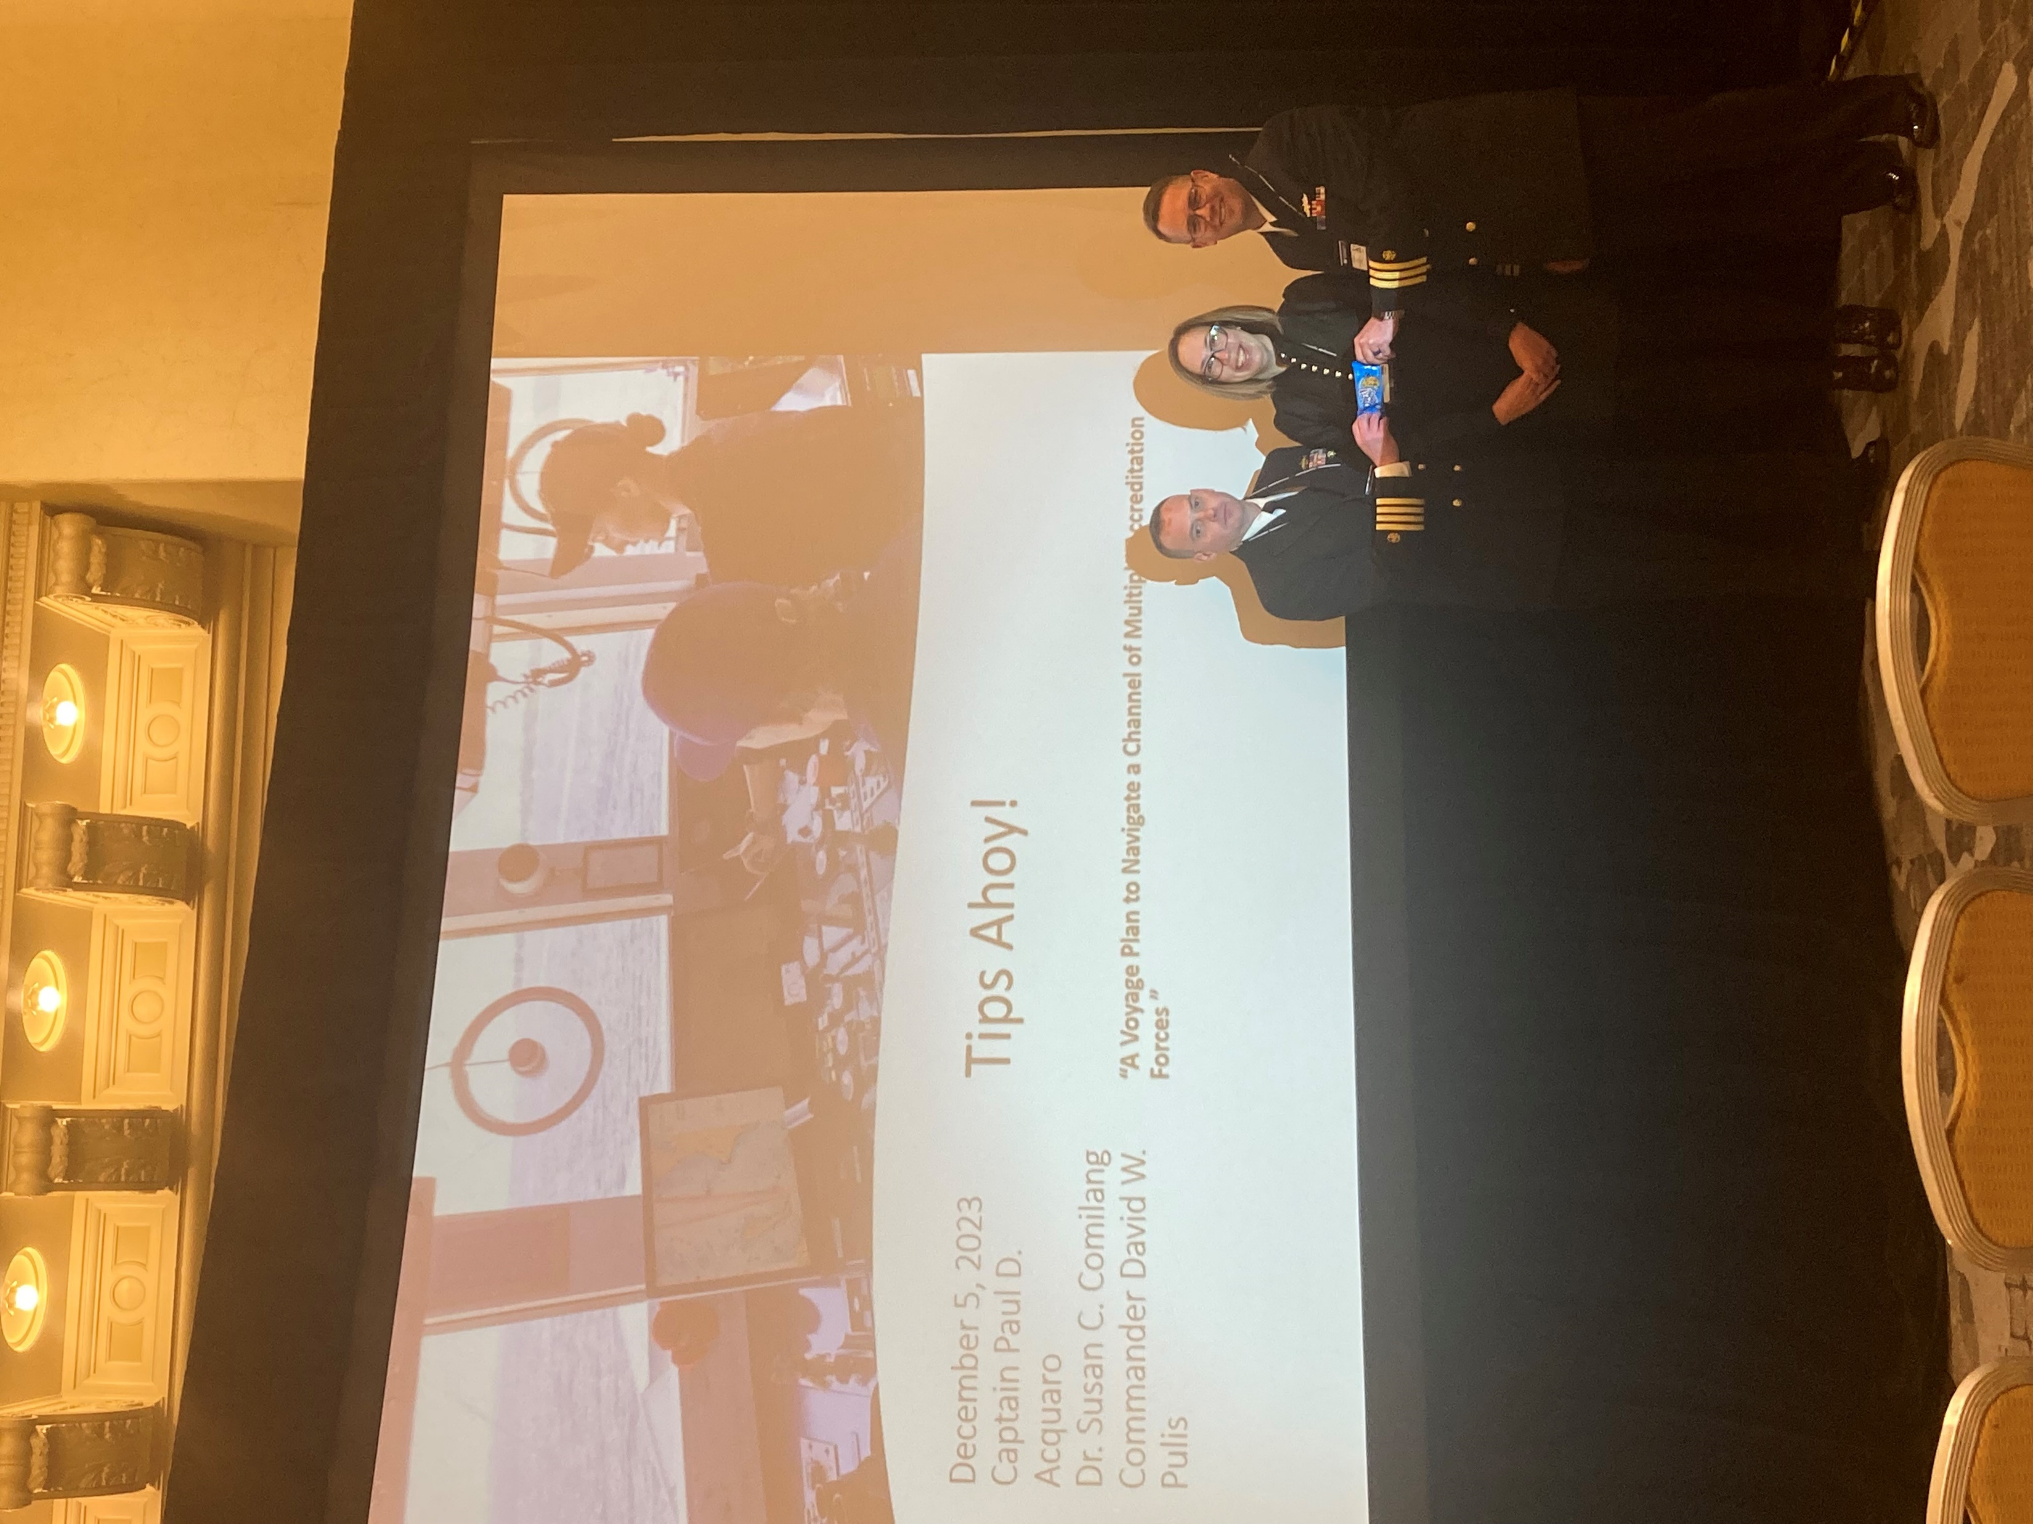
MSCHE Conference 2023, PA
“Tips Ahoy”
Capt. Paul Acquaro, Dr. Susan Comilang & CDR David Pulis
“Setting the Standard”
MIDN Sean Robinson, MIDN John Sullivan & MIDN Maeve Dellaria

Slide 8
Resources
MSCHE Standards & Requirements of Affiliation (13th Edition): https://www.msche.org/standards/thirteenth-edition/
MSCHE Link to USMMA Accreditation History: https://www.msche.org/institution/0419/
MSCHE Annual Conference & Call for Proposals: https://www.msche.org/annual-conference/
Upcoming MSCHE Webinars: https://www.msche.org/events/

